Slide 1
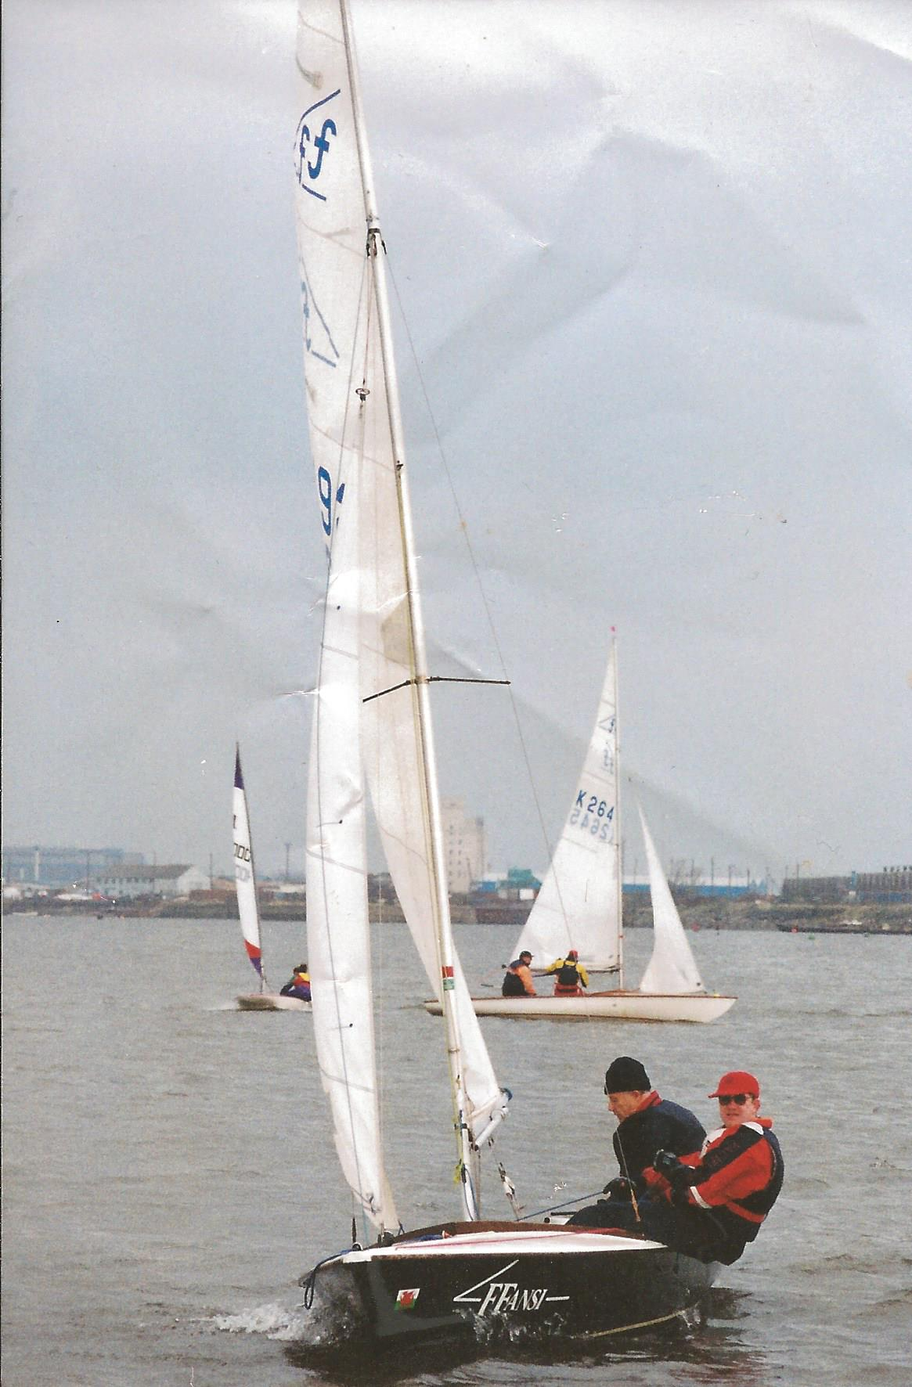

Slide 3
“What has happened to me has served to advance the Gospel.”
Philippians 2:12

Slide 4
“It has become clear throughout the palace guard…”
Philippians 2:13

Slide 5
Joseph
Jonah
Jesus

