Slide 1
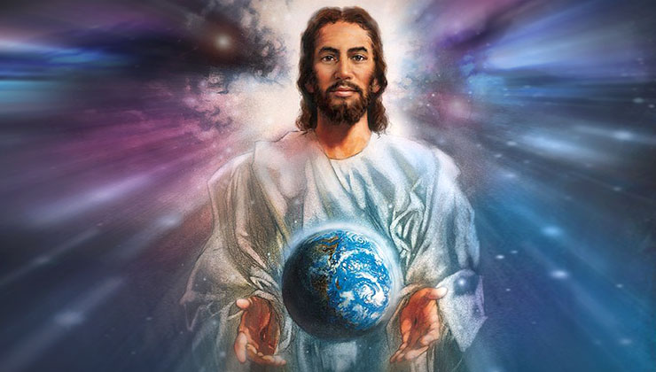

Slide 2
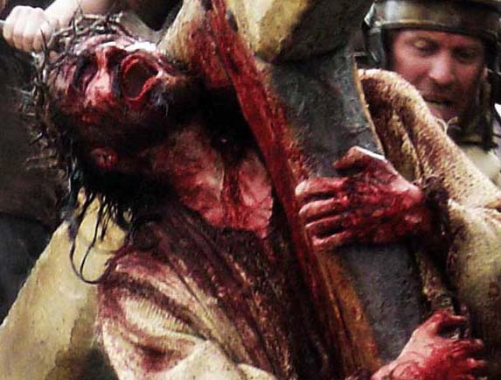

Slide 3
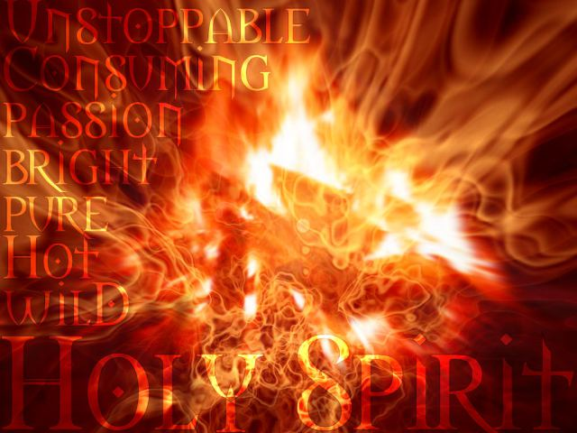

Slide 4
What gifts of the Holy Spirit did Jesus use?
Contrast this with how you would have done it?
Will you do anything differently after today?
How might the two different reactions that these miracles affect you in your practice of the spiritual gifts?

